Slide 1
BILLY GRAHAM CENTER
at Wheaton College

Slide 2
LEADING THROUGH THE COVID-19 CRISIS
By Dr. Ed Stetzer & Dr. Josh Laxton

Slide 3
If you keep silent at this time, relief and deliverance will come to the Jewish people from another place, but you and your father's family will be destroyed. Who knows, perhaps you have come to your royal position for such as time as this.
Esther 4:14

Slide 4
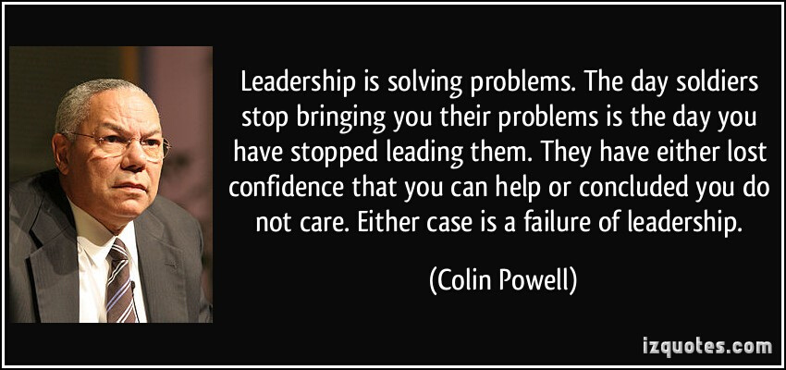

Slide 5
4 PHASES OF LEADING THROUGH THIS CRISIS
Never waste a crisis...

Slide 6
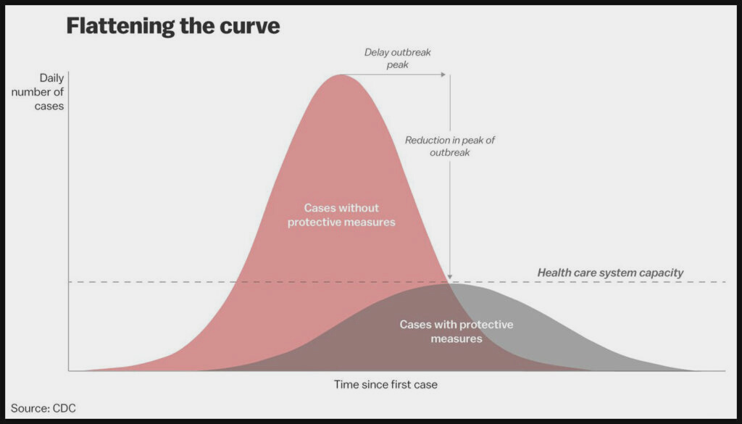
Here's where we are today
Notes:
We are just at the beginning of the crisis

Slide 7
PHASE 1
PAUSE & PIVOT
“Limitations, restrictions, and distancing are the seedbed for innovation, creativity, and community.”

Slide 8
PHASE 2
PREPARE
& PLAN
In light of what is coming...
What needs to change?
How does it need to change?
Who needs to lead the change?
Communication
Corporate worship
Giving
Pastoral Care
Small Group
Next Generation
Mission/evangelism strategy

Slide 9
Corporate Worship
Giving
BEST PRACTICES
Pastoral Care
Notes:
These are meant to be a framework and by no means are meant to tell you what to do.
They are meant to help you process what you can utilize as well as see what others are doing.

Slide 10
Corporate Worship
FB Live
Vimeo
YouTube
Zoom/Skype
Other Options
BEST PRACTICES
Record and post online
Record and deliver DVD via mail or in-person
Drive-In Church
Follow Up (after the online gathering)
Questions about God (invite them to a zoom chat)
Church Membership (text if interested)
Notes:
We will have links to Tutorials on our bgcruralmatters.com website

Slide 11
Suggestions to consider when using video communication
Shake it up (don't try to do online what you typically do in person)
Think shorter segments (online pedagogy suggests 7 minutes of information)
Try to be more personal (authentic)
Try to be engaging
Look into the camera (Rick Warren's Message)
Take Q&A (if possible)
BEST PRACTICES

Slide 12
Giving
Online (Generosity by LifeWay; Planning Center; Tithe.ly; )
Reoccurring giving through bank
Text to give (Tithe.ly; Trumpia)
Mail
Drop-off in person
Come by church and pickup
BEST PRACTICES

Slide 13
Pastoral Care Principles
Be Normative
Be Humble
Be Present
Be Learner
Be Active
Be Aware
Be Restful
BEST PRACTICES
Notes:
Be Normative—regulative principle people will struggle in this crisis
Be Humble—don't be a know it all
Be Present—Be what Jobs friends weren't... just present (don't try to fix people during this)
Be Learner— be informed globally, nationally, state, what others are doing, what others are saying
Be Active— you will have t
Be Aware—of those who cause dissension
Be Restful—you need rest

Slide 14
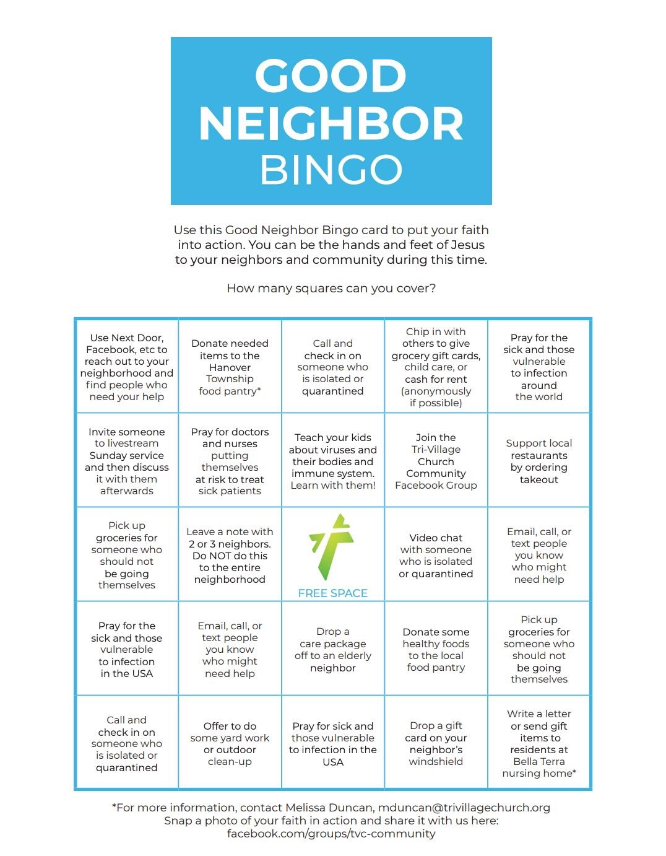
Pastoral Care Best Practices
Care
- Shut-ins/Elderly
- Personal check-ins
- Facebook Group
Prayer/Communication
- Phone Tree
- Facebook/Facebook Live
Discipleship
- YouVersion bible reading plans (groups)
- Family devotions (LifeWay)
- Right Now Media
- Start a book club
- Zoom or Skype (for small groups)
Students (Next Gen)
- Crossroads Farm (Communication Strategy)
Orange Curriculum
Social Media (Instagram, TikTok)
Gaming groups
Wednesday Night Live (YouTube; FB Live)
Mission
Notes:
Distribute families (old school deacon ministry style)
https://www.call-em-all.com/religious

Slide 15
Good Neighbor
Bingo Board
Pastoral Care and Mobilizing People on Mission

Slide 16
Other Missional Best Practices during COVID-19
Ask local nursing homes/senior assisted places what their needs are
Donate food to local food banks
Partnership with schools to deliver food; also see what families need meals during this time
Ask local homeless shelters how you can serve them during this time
Calling a local hospital to see how you can serve hospital staff; ask hospital chaplain how you can support them
Connect with local funeral homes to see how you can help serve during this time
Becoming a drive-by COVID-19 testing location
Be a person of peace through your social media presence
Prayer walk through your neighborhood/subdivision
Student pastors/leaders can host gaming tournaments online
Sidewalk messaging in your neighborhood or subdivision with hopeful messages
Lead out in a neighborhood/subdivision scavenger hunt for kids
Be proactive with publicizing information regarding Christian counseling for those effected by this crisis
Notes:
Distribute families (old school deacon ministry style)
https://www.call-em-all.com/religious

Slide 17
PHASE 3
ENGAGE & EXECUTE

Slide 18
Ideas are a commodity. Execution of them is not. (Michael Dell)
Having a vision for what you want is not enough. Vision without execution is hallucination. (Thomas Edison)
Quotes on Execution
Notes:
this is where the rubber meets the road.
The difference between being a smart leader and a successful leader, is execution.
Stephen Covey said, “Most leaders would agree that they’d be better off having an average strategy with superb execution than a superb strategy with poor execution.”
You can have a well thought out plan, but if you don't do the hard work of execution, you will notice it when the eye of the crisis hits.

Slide 19
Engage and Execute
PHASE 3
Communication
Delegation
Management
Flexibility
You cannot over-communicate in times of crisis
Engagement in the crisis might be different than their engagement in the calm
Overseeing the execution of the plan by making sure the vision is being fulfilled
Blessed are the flexible for they shall not be broken

Slide 20
RECOVER
&
REEMERGE
PHASE 4

Slide 21
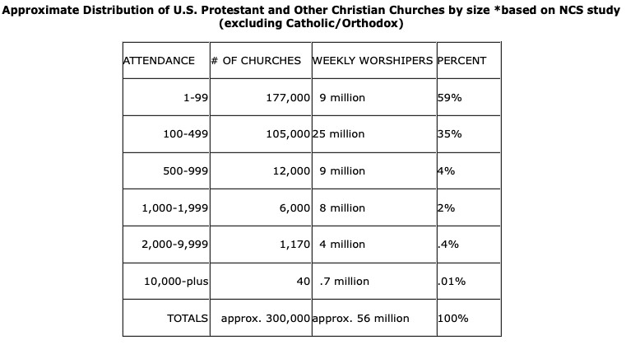
5 Phases of the Church’s Reemergence
Family Church (Less than 10)
House Church (Less than 20)
Cell Church (25–50)
Courtyard Church (Up to 100)
Small Church (Up to 250)
Medium Church (Up to 500)
Large Church (Up to 1999)
Mega Church (2000+)
Notes:
The chart was taken from : http://hirr.hartsem.edu/research/fastfacts/fast_facts.html#sizecong (The Hartford Institute for Religion Research)
These phases aren’t meant to be negative in any way if your church is small. This is simply meant to help people think about a gradual reemergence as bans of a “certain” number of people are lifted.
In each phases, you must think through a reemergence strategy of how you will practice your ecclesiology.
You will need to write policies and procedures for each ministry area
You will need to be prepared for a virus weary population
You will need to be prepared for how you will handle your next generation ministry
The recover and reemergence phase will be easier for some churches given their numbers.
The Coronavirus has landed a blow to the megachurch for the foreseeable future. The period of reemergence will be longer for the megachurch than the smaller churches.
And based upon where they started the large gathering bans, we have to assume that there will be a gradual lift of the gathering size recommended.

Slide 22
What will it look like to lead well during this crisis?
After this crisis subsides, what will we want to have been known for?
ASK THESE ?S
How can we bring flourishing to our community during this crisis?
What will it look like to be an Acts 2:42–47 church?
Notes:
Faith and wisdom aren't enemies. To exercise wisdom in light of what we are being told doesn't mean we don't have faith.
"the praise of the God of Christians be on the lips of all the people" Eusebius
What will Christians have to sacrifice in order to love one another well?

Slide 23
Rural Matters Institute
www.bgcruralmatters.com
Various COVID-19 Resources
www.coronavirusandthechurch.com
IMPORTANT INFO
Email Address
Joshua.laxton@wheaton.edu

Slide 24
BREAK UP INTO SMALLER GROUPS
R—relate to one another
(Who are you? Where do you serve?)
S—hare with one another
(What's going on in your community? Church? How are you navigating the crisis?)
V—ent to one another
(Is anything frustrating you?)
P—Ray for/with one another
(Prayer requests?)

